Slide 1

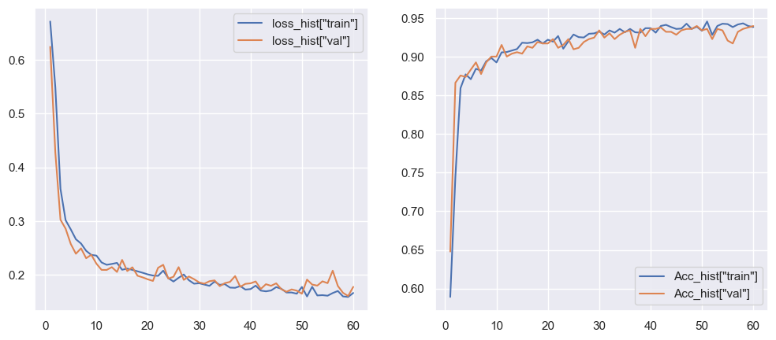
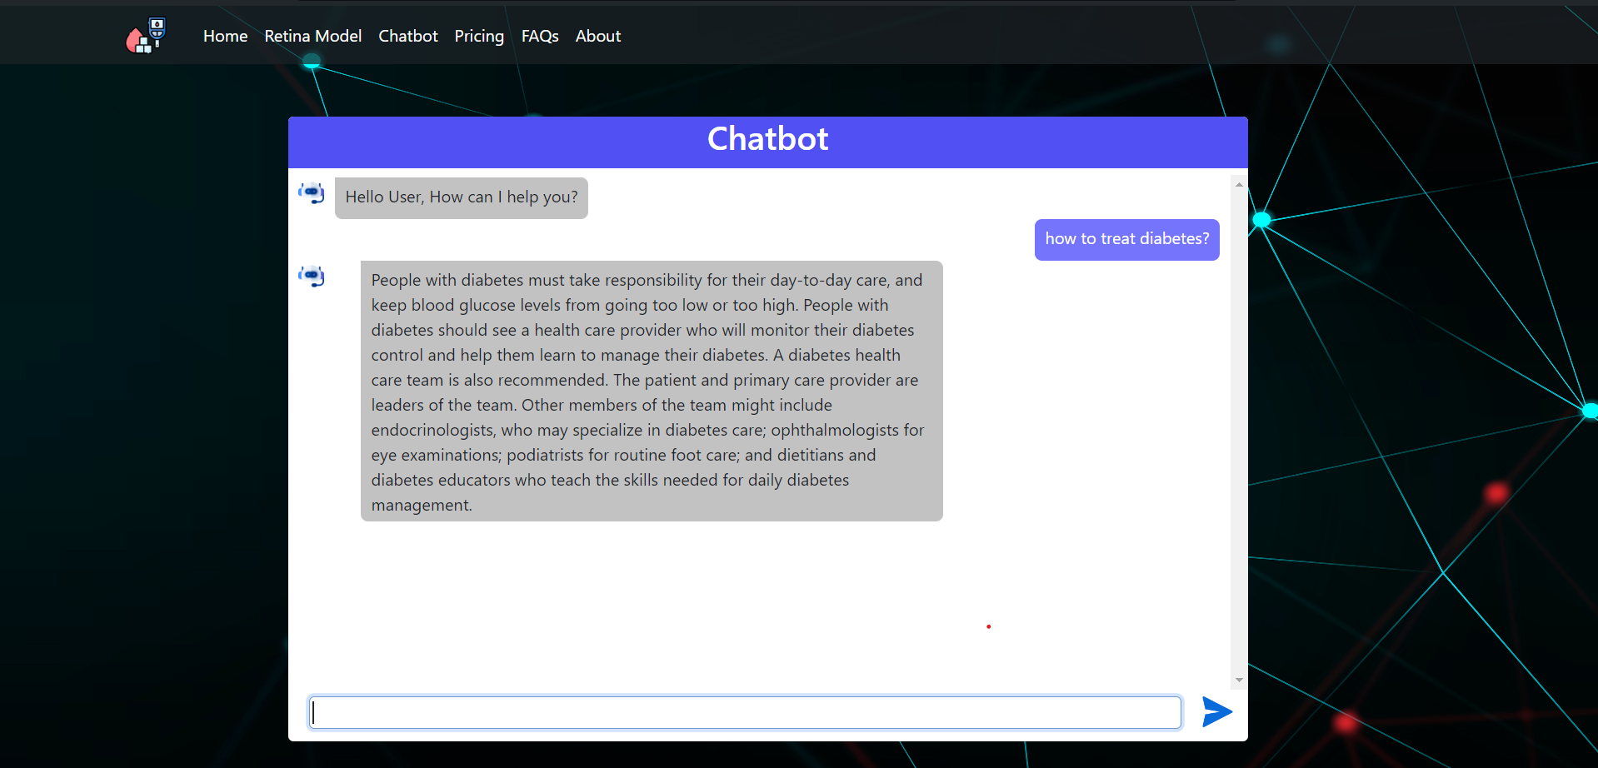
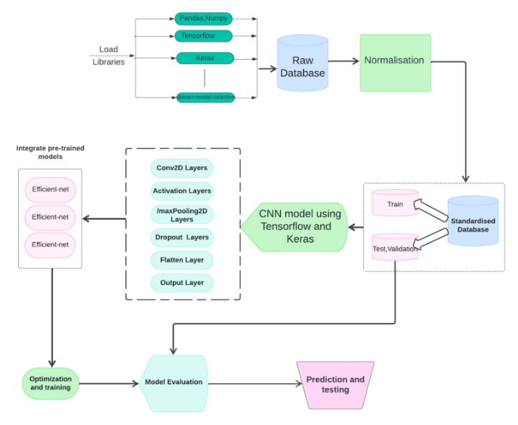
Personalized Healthcare Assistant
Group Member Details:
Chaitrali Ghule-12210688, Shubham Jadjav-12211681, Nikhil Jain-12210400,
Komal Bari-12210463
Department of CSE AIML
Vishwakarma Institute of Technology, Pune - 411037
Group Details
SY_CSAIML_ A_B2_9
Guide: Mrs. S. M. Jaybhaya
Introduction
METHODOLOGY/COMPONENTS USED
ABSTRACT
This study proposes a novel approach integrating machine learning techniques with generative artificial intelligence (Gen AI) for diabetes prognosis.
A Comprehensive dataset comprising genetic markers, and lifestyle factors from a cohort of diabetes patients, was collected.
Using this dataset, we trained machine learning models to predict disease progression, complications, and response to treatment.
ALGORITHM / MATHAMATICAL MODEL
CSV-Logistic regression, Decision Tree, and Random forest to predict if a patient has diabetes or not.
Retina Image-CNN, Pytorch deep learning algorithms to diverge diabetic and non-diabetic retina
Chatbot-LLM, Langchain, Gemini API to respond and answer the queries and doubts patient has on diabetes.
RESULTS AND DISCUSSIONS
PROBLEM STATEMENT
The incorporation of machine learning into clinical processes holds great promise to transform Diabetes Prognosis and have a substantial influence on patient care, particularly as technology advances.
The following Curves show training and validation loss as well as Training and Validation Accuracy.
The system also offers a Chatbot where patients can ask their doubts related to Diabetes.
Diabetes mellitus is a chronic metabolic disorder affecting millions worldwide. Predicting the prognosis of diabetes patients is crucial for personalized treatment and management.
Diabetes mellitus, a chronic metabolic disorder characterized by elevated blood glucose levels, is a significant global health concern with far-reaching implications for individuals and healthcare systems.
The complexities of diabetes management underscore the critical need for innovative approaches that go beyond traditional methods.
Advanced technologies, particularly natural language processing (NLP) and deep learning, present promising opportunities to transform how we address diabetes prevention and management.
Figure 2: Training and Validation Loss & Accuracy
OBJECTIVES
This project aims to capitalize on the convergence of quantitative datasets and qualitative insights obtained through field research.
By integrating these two streams of information, we seek to develop a robust system for predicting and managing diabetes.
This system will not only rely on objective data points but also incorporate subjective experiences and perspectives gathered from real-world scenarios.
SYSTEM DESIGN
Figure 3: Our System answering questions related to Diabetes
System Architecture/ Circuit Diagram:
The Chatbot is a Generative AI model which can answer the frequent doubts of Diabetes Patients and provide them with dietary options for a healthy life.
For image categorization, CNNs are the main architecture, utilizing Python libraries like os, shutil, cv2, Numpy, and pandas. Visualization is done with Seaborn and Matplotlib. Data handling includes train_test_split from sklearn. TensorFlow and Keras facilitate deep learning, using the Sequential model for constructing the neural network. Optimization uses Adam and Adamax, with categorical_crossentropy for loss. ImageDataGenerator aids data augmentation, while Conv2D, MaxPooling2D, Flatten, Dense, Dropout, and BatchNormalization define the network architecture. Regularizers help mitigate overfitting, providing a comprehensive framework for building and testing the model.
CONCLUSIONS/ NOVELTY FINDINGS
The Doctors can scan the retina images & perform retinopathy with the help of the ML model.
The Patients can input their required health history and get a rough prediction if the details put by them indicate if they have a risk of diabetes or not.
Doubt related to diabetes can also be resolved by the use of LLM chatbot.
Figure 1: Proposed System

